Slide 1
Sprint1 – Core Functionality
590Team1.info

Slide 2
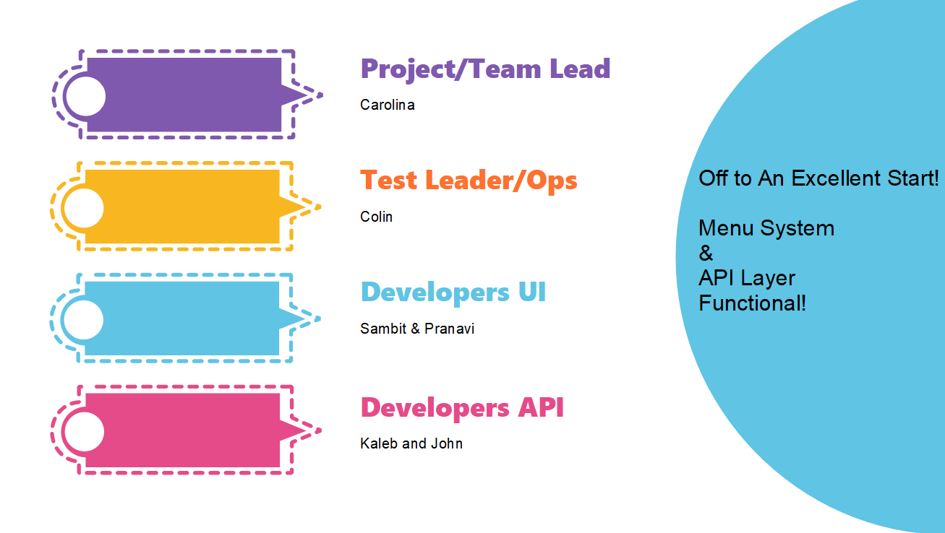

Slide 3
Focus Areas
1
Login
Profile-Setting
2
3
Certificates
Back-Office Progress
4
5
Project Administration

Slide 4
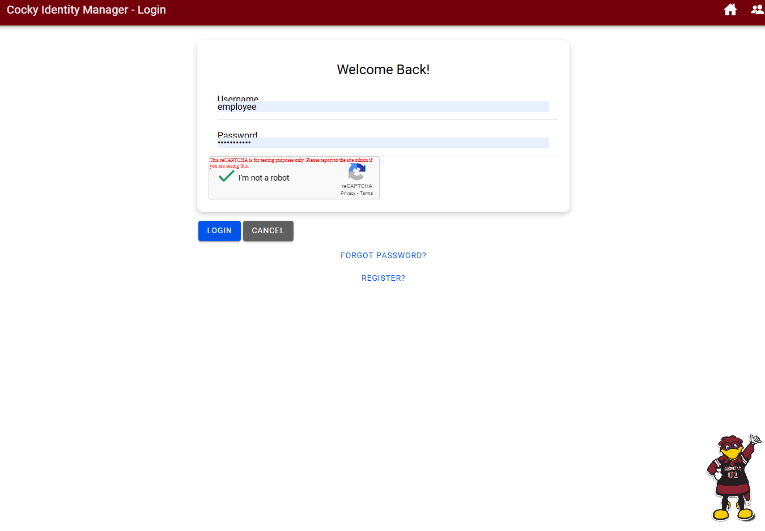
Login
1

Slide 5
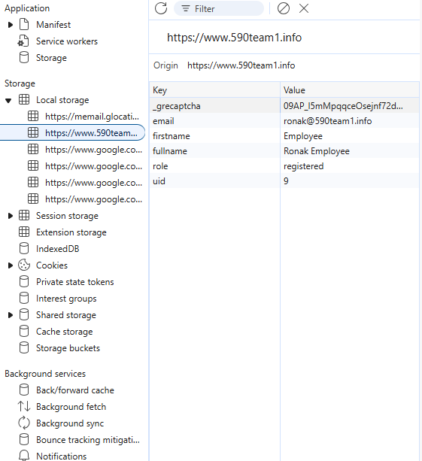
Profile Setting
2

Slide 6
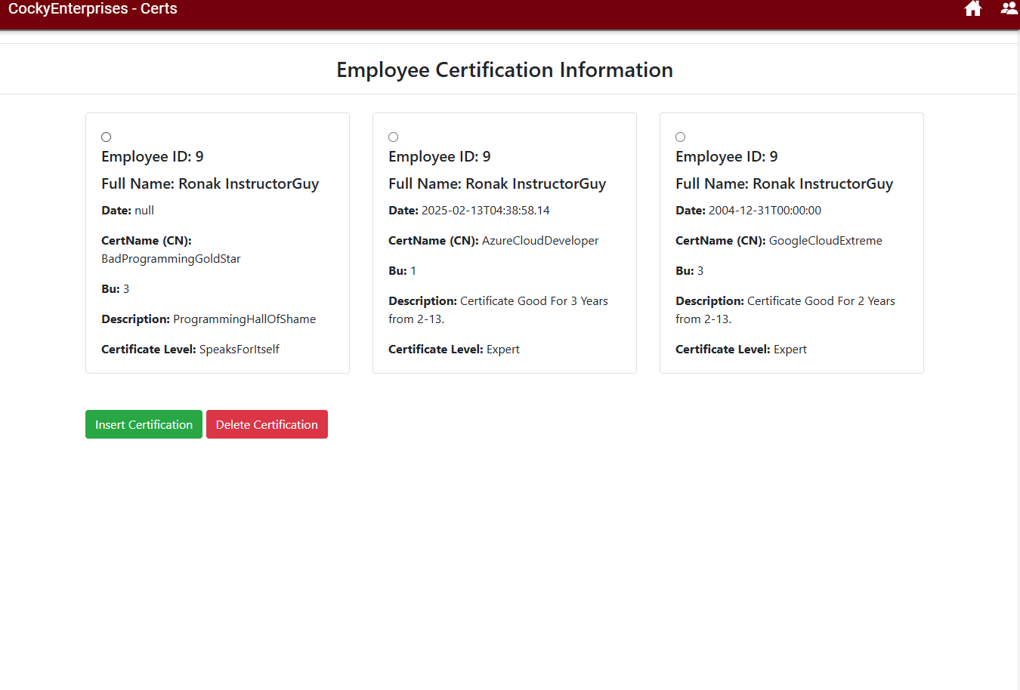
Certificates To Login
3

Slide 7
Menu Development
Schema Mapping
React Menus Are Scope Driven
Augmenting Base Schema to Meet UI Parameters
IonPages
Static Web Project
Bring Navigation Structure & Function
Sprint1
Serving NodeJS, And Static HTML Files.
Rapid ProtoTyping
Advanced Manager
Using JSON Flat Files to Streamline UI Development
Serving Microsoft Enterprise Features, IIS Security, Domain Authen
Page Level Locking
API Development
Locking Pages Based on Login Type
All Tables Reverse Engineered From SQL. Controllers in 60%+ Form.

Slide 8
Conclusions
Team1 On Track to Deliver the Rubric.
Team1 Is Doing Better With Team Activities
Team1 Has Identified Several Ways to Exceed The Rubric Time Permitting.

Slide 9
Team1 Demo

